Slide 1

iTrap
Rule Engine based Insider Trading Detection System
Team REBEL
FARIS SUMADI
YUZHE LI
ASHWIN MADHUSUDAN
SINDHU RAGHAVENDRA
CHRISTY JOSEPH ANOOP

Slide 2


Slide 3
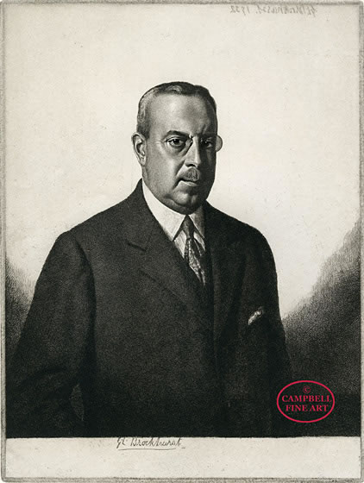

Biggest insider trading case of all time
Albert H. Wiggin
The Market Crash Millionaire

Slide 4





Existing Solutions

Slide 5

PROBLEM STATEMENT
We seek to provide an out-of-box solution for compliance departments to filter trade information based on a rules engine, aggregate cases for review, and functionally enhance cases with observations.

Slide 6

iTRAP

Slide 7
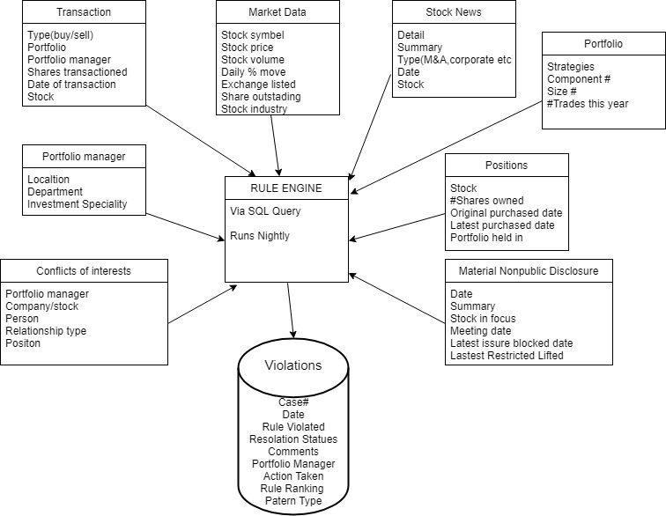
Abstract High level Diagram

Slide 8


Uniqueness
Out-of-Box Rules Engine
Rule Ranking / Categorization
Case Probability of Legitimacy (Decision Aid)
Observation Log per Case
Open Source Repository of Posted Observations

Slide 9
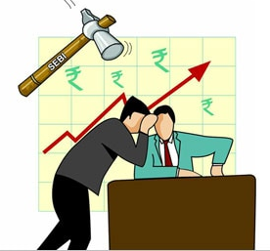
Rule Engine: Rule Types
Benchmark Tests
Industry standard tests.
Example: If any transaction type was executed within 15 days of a company merger or acquisition (M&A) announcement, then generate a case for analysis.
Critical Tests
Non-Industry Standards
Example: If a "buy" transaction type was executed within 15 days of a subsequent 10%-day stock price move upward, then generate a case for analysis.
Major Tests
Broader based tests
Example: If a transaction dollar amount is more than 10% of the portfolio's size (in $), then generate a case for analysis.

Slide 10


Implementation
Many procedures: one per rule (Complicated Rules)
The output of each procedure is a view of potential cases based on the rule
Each of these procedures calls another procedure that adds cases to the case table.
Creates a backup of the cases to avoid data mishaps.
Grants and permissions carefully chosen per users.

Slide 11
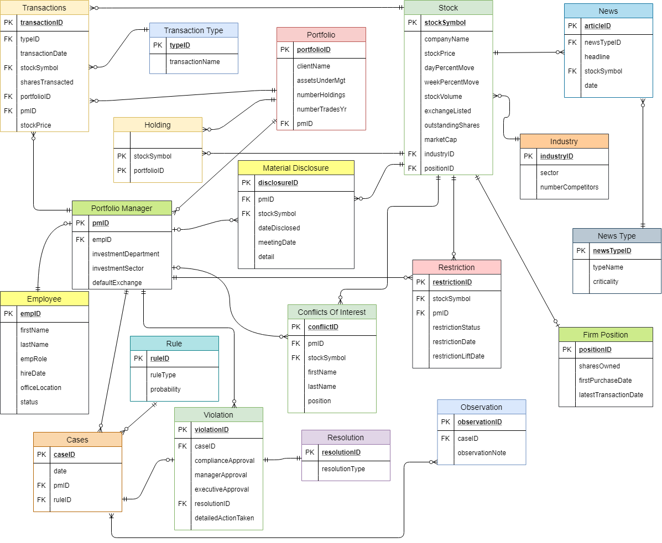

Slide 12

Impact of Application
Upon integration of data sources, this application will:
Allow analysts to focus on decision making as opposed to data collection
Allow the escalation of cases into violations and the posting of observations publicly
Many companies can work together to fight insider trading.
Example: Apple, Google and Microsoft.

Slide 13


What could have been done better?
The implementation of the UI was left out due to the complexity of the rules.
1
Insertion of the data with respect to the rule engine
2
However, the entire backend is working with the full-fledged use cases and rules engine.
3

Slide 14

Thank You!

